Slide 1
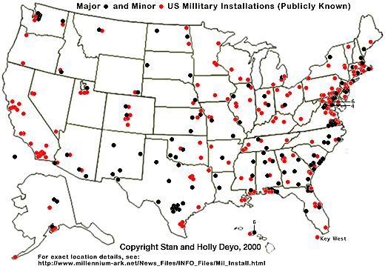
Raising Heart Disease Awareness in the Military
Harrison Cardiovascular Center

Slide 2
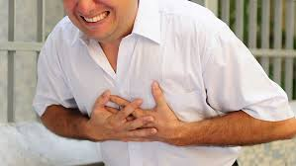
Flash Point
Due to the strong commitment of an all voluntary military, career soldiers are reaching older ages on active duty. This coincides with the age of onset of heart disease.

Slide 3
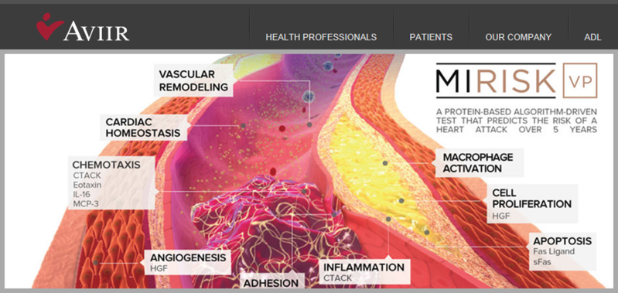
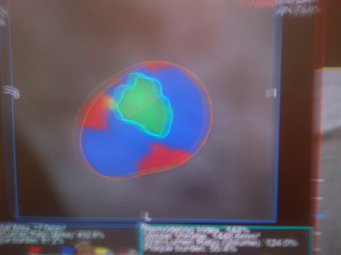
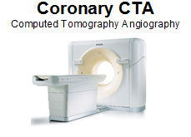

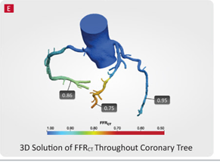
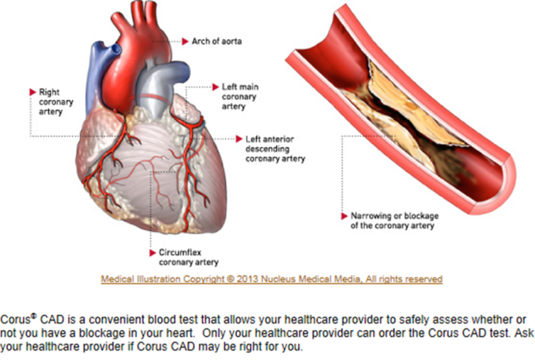
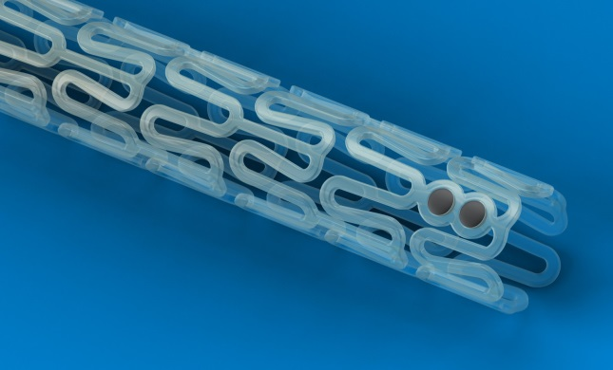
Early detection of Coronary Artery Disease
<50% lipid core and thin cap analysis --------> THIN CAP -------> ?
CCTA + + Node --->
>50% HeartFlow Analysis -------> FFRct <80 --------> possible BAVS

Slide 4
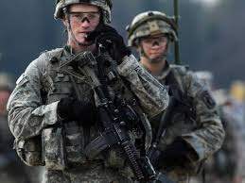
Result of Military CCTA Study
Objective: Looked at the possibility of using CCTA as a method of cardiac disease screening in the military
Methods: A retrospective chart review of 25 soldiers that underwent CCTA
Results: 5/25 patients had plaque discovered on CCTA. Three had stable plaques and two were vulnerable. Four were men over 40 and one was a female over 50.
Conclusion: Proposal of screening all military male over 40 and female over 50 with CCTA to identify presence of plaque

Slide 5
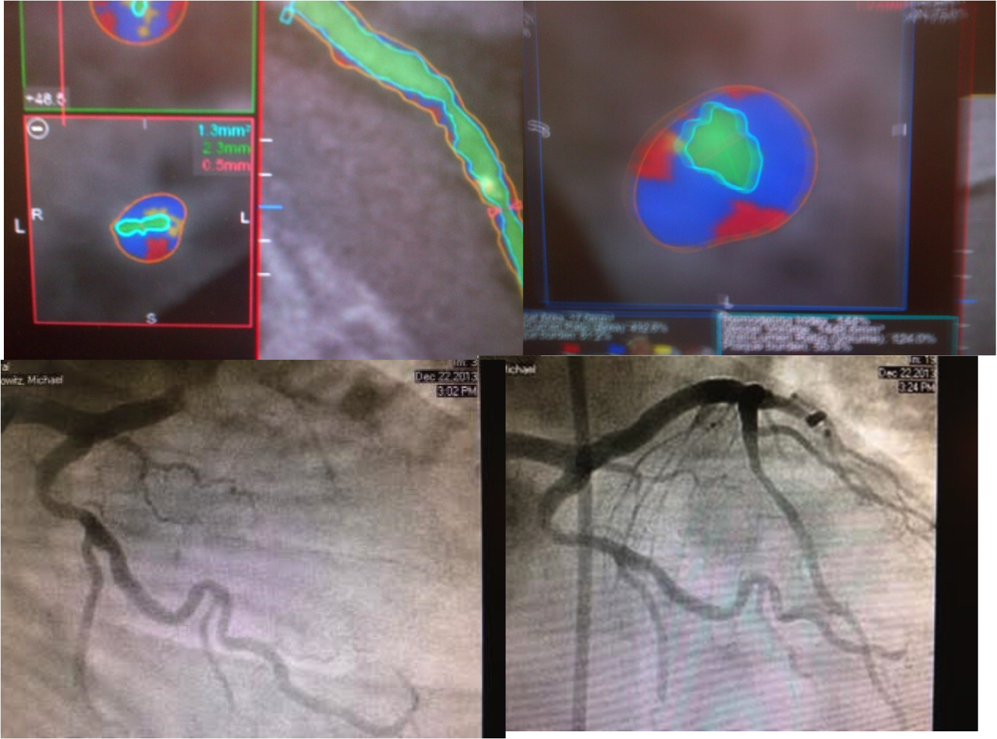
SOMA Study Example of early detection of CAD: Asymptomatic 48 y/o soldier with a family history of heart disease underwent CCTA
A lipid rich-core and thin fibrous cap was found on CCTA (vulnerable plaque)
Four cardiac medications prescribed and angioplasty was scheduled but the patient had a myocardial infarction in four days. Tampa Fire Rescue took to patient to Tampa General hospital where he was saved by emergent angioplasty and stenting.

Slide 6
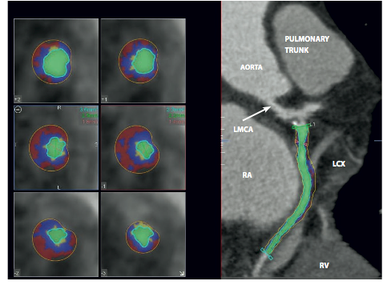
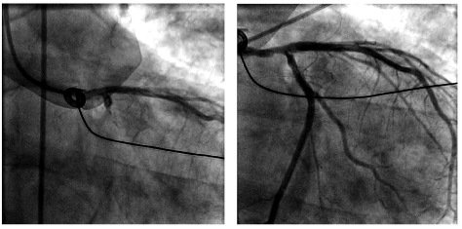
AHA Study: More evidence that CCTA is a good predictor of future ACS Events
15 asymptomatic patients underwent CCTA
Of the patients found with plaques, two were determined to be at high risk of rupture
One had a STEMI 12 days after a CCTA and the other had a STEMI in185 days

Slide 7
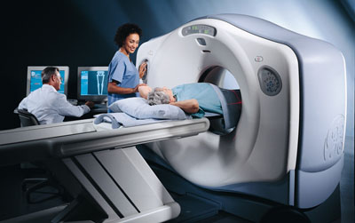
CCTA
Low radiation exposure
Excellent diagnostic accuracy
Coronary Calcium Detection
99.9% Negative Predictive Value
Plaque characterization
Low Cost
10 minute procedure

Slide 8
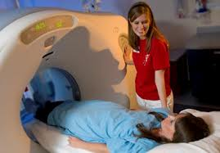
Preparation for CCTA
No caffeine or decaf for 12 hours before the test
May have to take Toprol-XL (Metoprolol) 2 days before test and day of test
No food or drink 3 hours prior to test

Slide 9
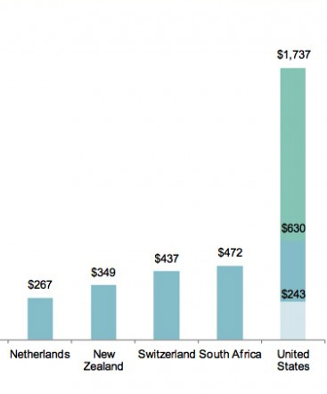
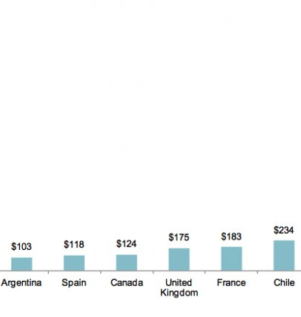
COST
$264
CURRENT PRICE POINT

Slide 10
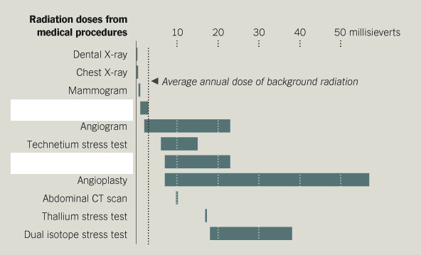
Radiation Exposure
Prospective CCTA
Retrospective CCTA

Slide 11
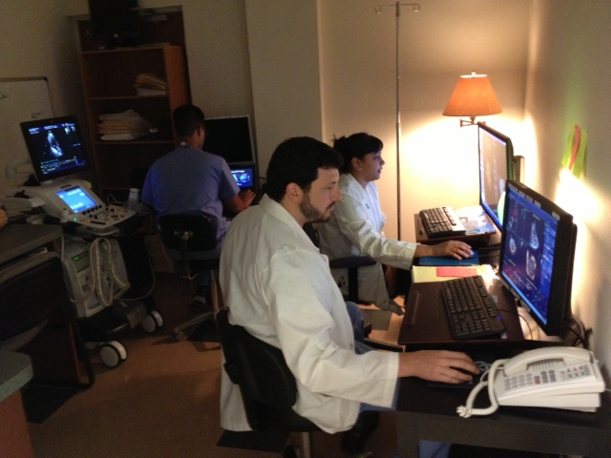
PrivaCors Core Laboratory

Slide 12
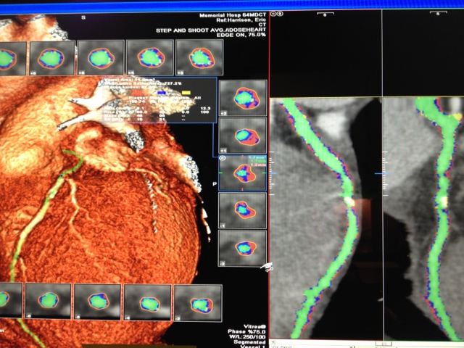
PrivaCors Core Laboratory
Chooses and Contracts with US CT Centers for quality control
Proprietary software with 24/7 staffing with cardiac imaging specialists
Post processing, image review, image sharing, and plaque risk assessment
Quality Control: Technical guidance for image acquisition

Slide 13
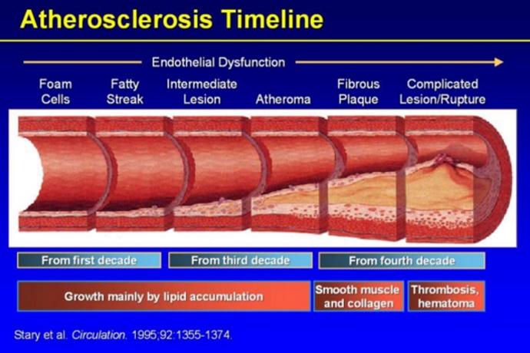
Treatment Based on Results
No Plaque means no worry!
Minimal Calcification is low risk
Mixed Plaque will get aggressive treatment
Severe Stenosis will get aggressive treatment
Vulnerable Plaque is our highest priority

Slide 14


Our Proposal
We propose CCTA for the following:
MALE MILITARY > 40 years of age
&
FEMALE MILITARY > 50 years of age

Slide 15
References
1) Singh M, Kroman A, Tariq H, Amin Shetal, Morales A, Cahill K, Harrison EE. Special Operations Soldier with Cardiac Family History. JSOM. 2014.
2) Hartlage G, Patel A, Amin S, Morales A, Harrison EE. No One Left Behind. SOMA. 2014.
3) Singh M, Tariq H, Amin S, Morales A, Harrison EE. Are Vulnerable Plaques in Vulnerable Patients Predictive of ST Elevation Myocardial Infarction? AHA. 2014.
4) Tariq A, Amin S, Singh M, Morales A, Cahill K, Harrison EE. Predicting Heart Attack in a Patient Post-Radiation Therapy Using Plaque CCTA Analysis and Serum Biomarker Test. OncoReview. 2014.
5) Hadamitzky et al. Optimized Prognositic Score for Coronary Computed Tomographic Angiography: Results From the CONFIRM Registry: J Am Coll Cardiol 2013;62(5):468-76
6) Pontone G, Andreini D. A Long-Term Prognostic Value of CT angiography and Exercise ECG in Patients with Suspected CAD. J Am Coll Cardiol Imaging 2013: 6(6): 641-50
7)Lloyd-Jones D, Adams R, Carnethon M, et al. Heart disease and stroke statistics – 2009 update: a report from the American Heart Association Statistics Committee and Stroke Statistics Subcommittee. Circulation. 2009; 119:480–486.
8) Cross DS et al. Coronary risk assessment among intermediate risk patients using a clinical and biomarker based algorithm developed in validated in two population cohorts. CMRO 2012;28(11):1819-30
9) Fishbein, Michael C, Robert J. Siegel. How Big Are Coronary Atherosclerotic Plaques That Rupture? Circulation.1996; 94: 2662-2666

