Slide 1


Concierge Medicine American Academy of Private Physicians
Notes:
Images: courtesy of practicedock

Slide 2
Concierge Medicine American Academy of Private Physicians
AAPP Estimates over 3500 US physicians practice some form of concierge medicine
Physicians have limited number of patients ensuring enhanced healthcare and improved time/availability for each individual patient.
24/7 access to a personal physician for an annual fee
Same/next day appointments
Physician's private cell phone number & email
More time spent in the office during physician-patient interactions.

Slide 3
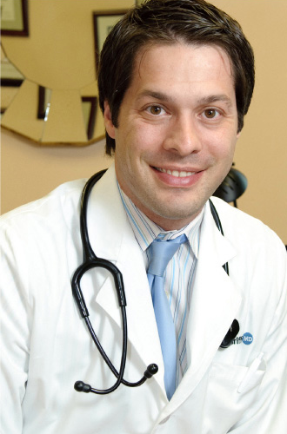
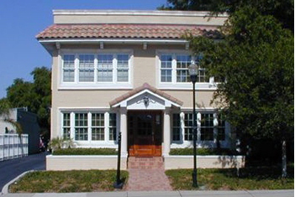
Concierge Physicians
Dr. Radley Griffin M.D. Board Certified Family Medicine – Tampa, Florida
http://www.radleygriffinmd.com/dr_griffin.php

Slide 4

Concierge Physicians
Dr. William (Trae) Ingram, M.D. Board Certified Family Medicine – Des Moines, Iowa
http://conciergemedicineiowa.com/meet-the-team/

Slide 5
Concierge Medicine American Academy of Private Physicians
Use cutting edge tools & technology to fulfill your mission of providing the best healthcare to your patients.

Slide 6
Coronary Artery Disease
The leading cause of mortality in the USA, causing 23.7 % of total deaths and 596, 577 deaths annually.
New technology offers non-invasive means to diagnosing CAD severity in your patients.

Slide 7
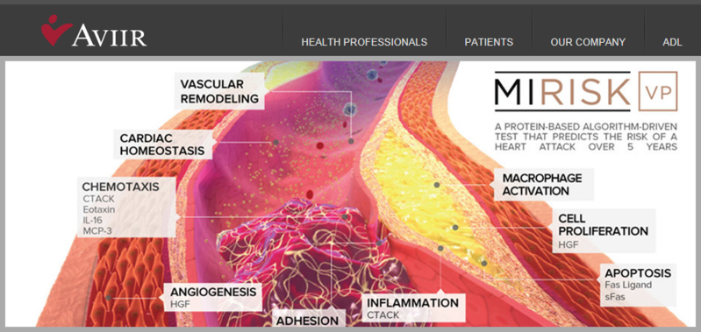
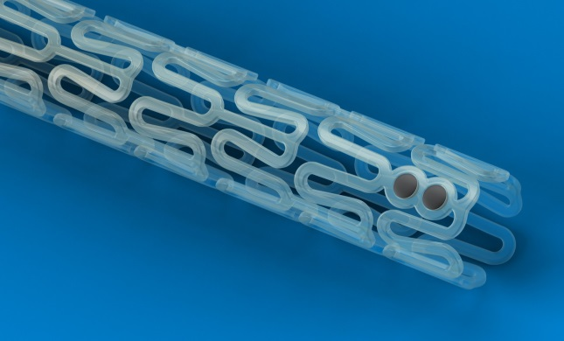

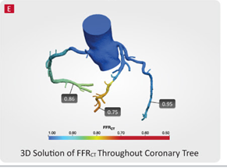
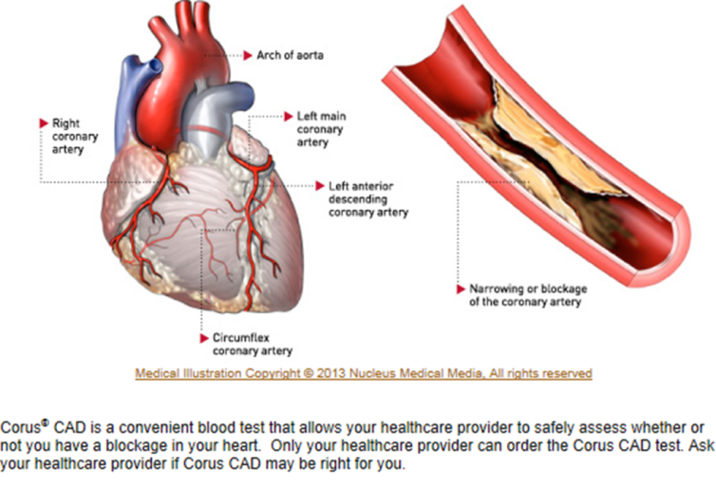
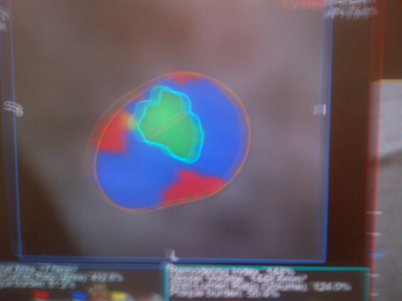
Screening for Coronary Artery Disease
<50% lipid core and thin cap analysis --------> THIN CAP -------> ?
CCTA + + Node --->
>50% HeartFlow Analysis -------> FFRct <80 --------> possible BAVS

Slide 8
Prototype Study: Military CCTA
Objective: CCTA as a screening method for CAD in military
Methods: A retrospective chart review of 40 soldiers that underwent CCTA
Results: 9/40 patients had plaque
4 had stable plaques
5 had vulnerable plaques.
38 were men over 40 and 2 was a female over 50.
Conclusion: Vulnerable plaques as defined by CCTA can be predictive of future myocardial infarctions

Slide 9
Military CCTA Study
Proposal:
Screening of all military males over 40 and
military females over 50 with CCTA to identify
presence of vulnerable plaque and prevent
heart attacks

Slide 10
Index Case From Military Study
Asymptomatic 48 yo soldier with a family history of heart disease
CCTA demonstrated a vulnerable plaque
Four cardiac medications prescribed and angioplasty was scheduled
→however the patient had a MI in 4 days!!!
Tampa Fire Rescue took pt to TGH where he was saved by emergent angioplasty and stenting
Notes:
A lipid rich-core and thin fibrous cap was found on CCTA

Slide 11
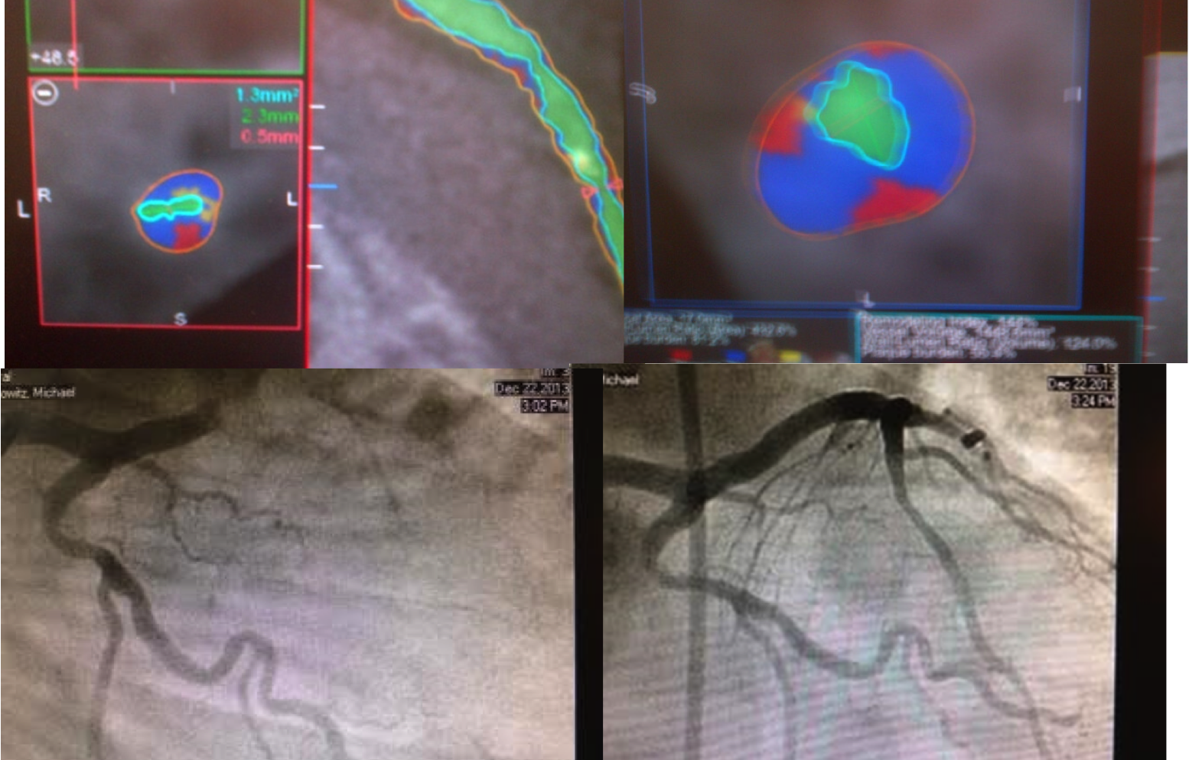
Index Case – CCTA Results
Green: Lumen
Blue: Fibrous
Red: Lipid

Slide 12
AHA Study – Second Study
15 asymptomatic patients underwent CCTA
Results:
→2 showed vulnerable plaque on CCTA
→Pt one had MI 12 days after CCTA!!!
→Pt two had MI 185 days after CCTA!!!

Slide 13
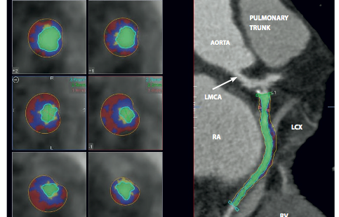
AHA Study – Second Study
Green: Lumen
Blue: Fibrous
Red:
Lipid

Slide 14
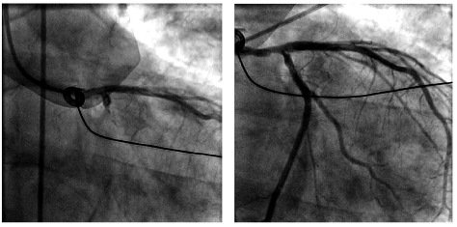
AHA Study – Second Study

Slide 15
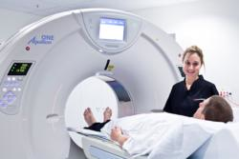
Coronary Computed Tomography Angiography - CCTA
Low radiation exposure
Excellent diagnostic accuracy regardless of patient status
Coronary Calcium Detection
99.9% Negative Predictive Value
Plaque characterization
Low Cost
10 minute Procedure

Slide 16
Preparation for CCTA
No caffeine or decaf for 12 hours before the test
May have to take Toprol-XL (Metoprolol) 2 days before test and day of test
No food or drink 3 hours prior to test

Slide 17
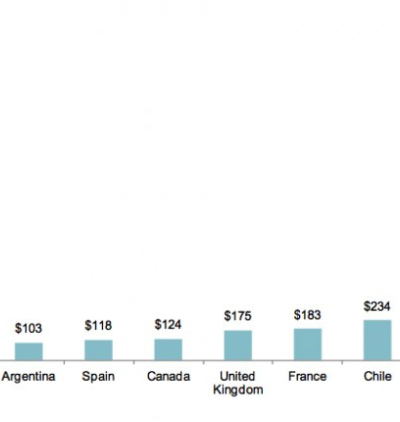
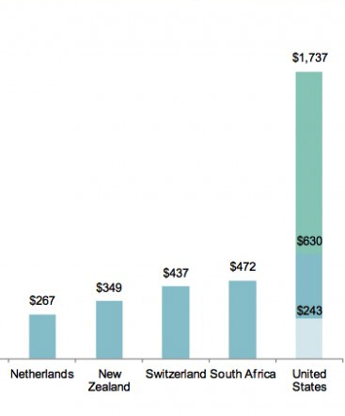
COST
CURRENT PRICE POINT
$ 264

Slide 18
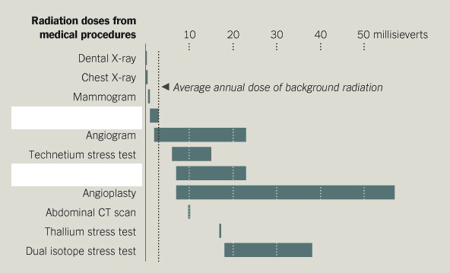
Radiation Exposure
Prospective CCTA
Retrospective CCTA

Slide 19
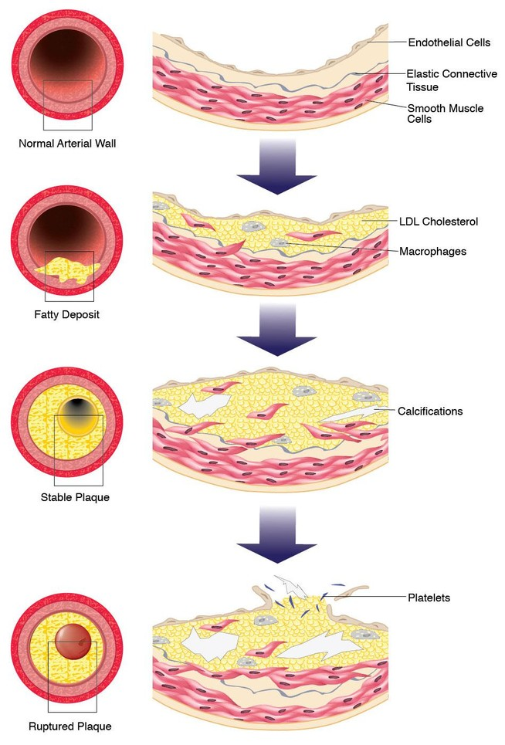
Treatment Based on Results
No Plaque means no worry!
Minimal Calcification is low risk
Mixed Plaque will get aggressive treatment
Severe Stenosis will get aggressive treatment
Vulnerable Plaque is of highest priority
Notes:
https://cias.rit.edu/media/uploads/faculty-s-projects/287/1271_showcase_project_detail_item.jpeg

Slide 20
HeartFlow
Non-invasive method to calculating FFR using fluid dynamics
No additional image acquisition, radiation or modification to imaging protocols
FFR-CT leads to marked increase in accuracy, specificity and PPV without effecting sensitivity

Slide 21
PROTE-CT Study
Using CCTA, protein biomarker risk assessment, and FFR –CT to identify vulnerable plaques and follow up patients for any future MI.

Slide 22


Our Proposal to Save Lives
CCTA for the following:
Law Enforcement/Firefighters/Military
→ MALE Patients > 40
and
→ FEMALE patients > 50
Notes:
-http://www.iaff.org/HR/ReproductiveHealth.htm
-Images: http://www.aapp.org

Slide 23




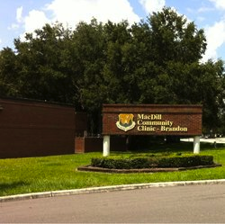


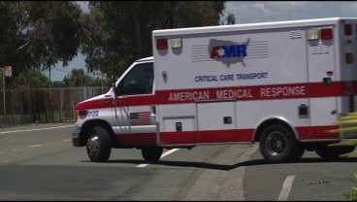
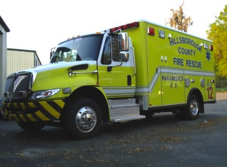
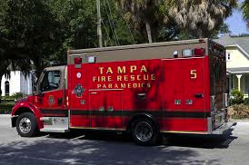
CHEST PAIN CENTER

Slide 24
References
1) Singh M, Kroman A, Tariq H, Amin Shetal, Morales A, Cahill K, Harrison EE. Special Operations Soldier with Cardiac Family History. JSOM. 2014.
2) Hartlage G, Patel A, Amin S, Morales A, Harrison EE. No One Left Behind. SOMA. 2014.
3) Singh M, Tariq H, Amin S, Morales A, Harrison EE. Are Vulnerable Plaques in Vulnerable Patients Predictive of ST Elevation Myocardial Infarction? AHA. 2014.
4) Tariq A, Amin S, Singh M, Morales A, Cahill K, Harrison EE. Predicting Heart Attack in a Patient Post-Radiation Therapy Using Plaque CCTA Analysis and Serum Biomarker Test. OncoReview. 2014.
5) Hadamitzky et al. Optimized Prognositic Score for Coronary Computed Tomographic Angiography: Results From the CONFIRM Registry: J Am Coll Cardiol 2013;62(5):468-76
6) Pontone G, Andreini D. A Long-Term Prognostic Value of CT angiography and Exercise ECG in Patients with Suspected CAD. J Am Coll Cardiol Imaging 2013: 6(6): 641-50
7)Lloyd-Jones D, Adams R, Carnethon M, et al. Heart disease and stroke statistics – 2009 update: a report from the American Heart Association Statistics Committee and Stroke Statistics Subcommittee. Circulation. 2009; 119:480–486.
8) Cross DS et al. Coronary risk assessment among intermediate risk patients using a clinical and biomarker based algorithm developed in validated in two population cohorts. CMRO 2012;28(11):1819-30
9) Fishbein, Michael C, Robert J. Siegel. How Big Are Coronary Atherosclerotic Plaques That Rupture? Circulation.1996; 94: 2662-2666
10) Concierge doctors say an annual fee can mean better care (Tampa Bay Times) http://www.tampabay.com/news/health/medicine/concierge-doctors-say-an-annual-fee-can-mean-better-care/1092290

